Slide 1
Steps to finishing the typed research report from Career Exploration…
Check that you have answered every question in your OWN words
Check that you have formatted all questions and answers
It is clear what the questions are and answers because of formatting
Do you have a title page?
Have you sourced all of your information?
Do you have a title page?

Slide 2
Make sure you address it in as much detail as possible! Question 1 Example below
What do people in this occupation do on the job? (i.e. their duties, activities, responsibilities)
A teacher’s responsibilities are:
Plan engaging lessons for students of all learning styles
communicate with students and parents/guardians
Collaborate with colleagues
Creating assignments and tests to assess how much students understand the material
https://ca.indeed.com/viewjob?jk=fc9c23bf5851cef6&tk=1dngkrjc2fihf800&from=serp&vjs=3

Slide 3
Bibliography
You can use any citation site you would like
A good one is Easy Bib. This is easily found by googling Easy Bib.

Slide 4
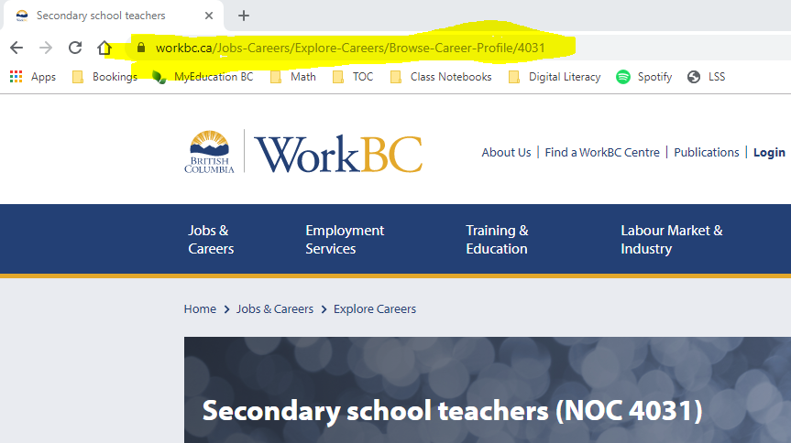
Step 1: All you need to do is copy and paste the URL of the site you used into the application

Slide 5
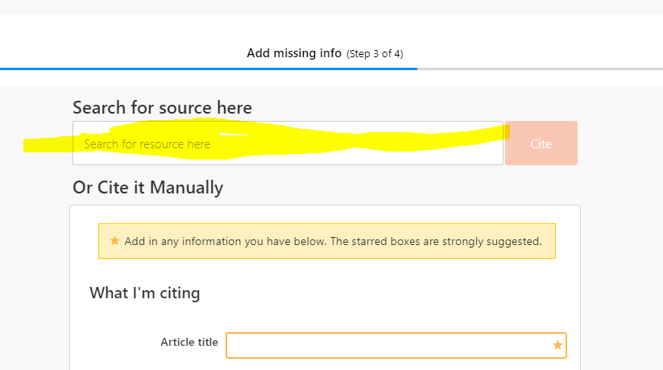
Step 2: Paste the URL into the box on Easybib’s website.

Slide 6
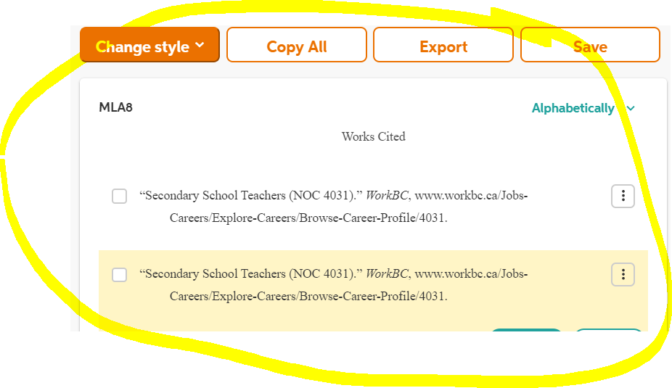
Step 3: Copy and paste citation onto your word document

