Slide 1
Worksafe – recognizing hazards and equipment

Slide 2
MOST COMMON WAYS OF GETTING HURT
Lifting objects when working as retail clerks and shipper-receivers
Falling from ladders, scaffolding, or other raised platforms
Using knives in food service or retail
Working with hot substances or equipment in restaurants
Driving or riding in vehicles, and working near mobile equipment
Using food slicers in restaurants or supermarkets
Working near any equipment or machinery when it’s in operation

Slide 3
Hazards part ONE
Physical hazards
Sources: falling, slipping/tripping, being struck, being caught in machinery, being cut, or being burned.
Injuries bruising, broken bones, cuts and gashes, and burns.
Chemical hazards
Sources: exposure to unsafe chemicals.
Injuries: burns, asphyxiation, rashes, or illness.
Ergonomic hazards
Sources: improper lifting, repetitive motions, or overextending.
Injuries: sprains and strains of any joint or muscle, as well as repetitive strain injuries such as carpal tunnel syndrome.

Slide 4
Hazards part TWO
Biological hazards
Sources: exposure to bacteria, viruses, parasites, molds, and other hazardous life forms.
Injuries: diseases and poisoning.
Natural environment hazards
Sources: exposure to cold, heat, sun, or water.
Injuries: heat stress, hypothermia, frostbite, sunburn, and drowning.
Psychosocial hazards
Sources: stress, workplace violence, bullying, shiftwork, distractions.
Injuries: Any of these situations can lead to an accident and cause injuries and/or mental health issues.

Slide 5
Other risk factors….
Working alone
Working in a confined and/or cluttered space
Worker is fatigued, distracted or impaired by drugs or alcohol

Slide 6
Please pause and work through this with a partner.
Server at a restaurant – click on this link by using CTRL + CLICK and see if you can spot all of the hazards in the picture.

Slide 7
Steps to assess and reduce risk of dangerous situations
What is unsafe? What are the hazards?
Why is it a hazardous situation? What could happen? What injuries could occur?
What could be done to eliminate or minimize the hazard?

Slide 8
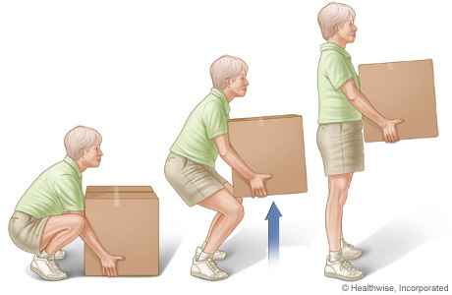
Ways to minimize risk
Keep workspace clear and uncluttered
Follow safe lifting procedures
Wear appropriate protective equipment
Pay attention
Follow all safety procedures
Ask questions and for help, if required

Slide 9
Personal Protective Equipment
Your turn to do some research!
Please follow the instructions on your worksheet.

Slide 10
Your turn to try and identify the hazards
You will have a chance to assess a situation in a group by using the three steps we have gone over by writing (10 minutes)
You will then have to present your findings to the class by taking turns (1-2 minute presentations)

